Slide 1
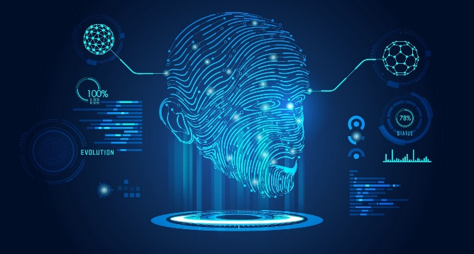
Multi-Agent Deep Reinforcement Learning for UAV-based Services IETF Forum
Prof. Joongheon Kim Korea University, School of Electrical Engineering Artificial Intelligence and Mobility Laboratory https://joongheon.github.io joongheon@korea.ac.kr

Slide 2
Outline
Deep Reinforcement Learning (DRL) Concepts
Imitation Learning Concepts
Multi-Agent DRL for UAV-based Services

Slide 3
Introduction to RL
Brief History and Successes
Minsky’s PhD thesis (1954): Stochastic Neural-Analog Reinforcement Computer
Analogies with animal learning and psychology
Job-shop scheduling for NASA space missions (Zhang and Dietterich, 1997)
Robotic soccer (Stone and Veloso, 1998) – part of the world-champion approach
When RL can be used?
Find the (approximated) optimal action sequence for expected reward maximization (not for single optimal solution)
Define actions and rewards. These are all we need to do.

Slide 4
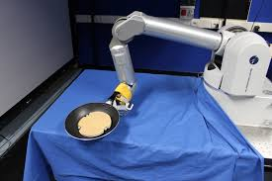
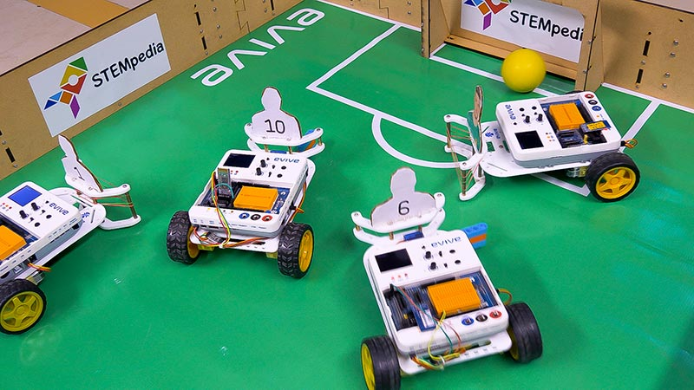
Introduction to RL
Action Sequence (also called Policy, later in this presentation)!

Slide 5
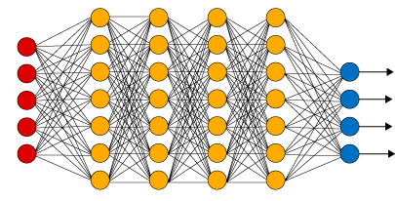
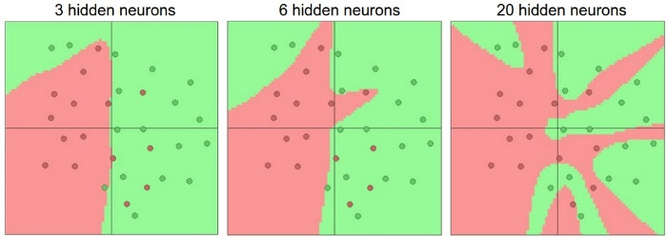
Introduction
How Deep Learning Works?
Deep Learning Computation Procedure
Input
Multi-Layer Perceptron (MLP)
Output
Deep Learning Model Setup
MLP, CNN, RNN, GAN, or Customized
# Hidden Layers, # Units, Input/Output, …
Cost Function / Optimizer Selection
Training (with Large-Scale Dataset)
Input: Data, Output: Labels
Learning → Weights Updates for Cost Function Minimization
Non-Linear Training (Weights Updates) for Cost Minimization: GD, SGD, Adam, etc.
Inference / Testing (Real-Word Execution)
Input: Real-World Input Data
Output: Interference Results based on Updated Weights in Deep Neural Networks

Slide 6
Introduction
How Deep Learning Works?
Deep Learning Computation Procedure
All weights in units are trained/set (under cost minimization)
Input
MLP
Output
Deep Learning Model Setup
MLP, CNN, RNN, GAN, or Customized
# Hidden Layers, # Units, Input/Output, …
Cost Function / Optimizer Selection
Training (with Large-Scale Dataset)
Input: Data, Output: Labels
Learning → Weights Updates for Cost Function Minimization
INPUT: Data
One-Dimension Vector
OUTPUT: Labels
One-Hot Encoding
Inference / Testing (Real-Word Execution)
Input: Real-World Input Data
Output: Interference Results based on Updated Weights in Deep Neural Networks
We need a lot of training data for generality (otherwise, we will suffer from overfitting problem).

Slide 7
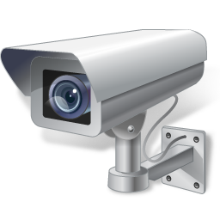
Introduction
How Deep Learning Works?
Deep Learning Computation Procedure
Trained Model
Deep Learning Model Setup
MLP, CNN, RNN, GAN, or Customized
# Hidden Layers, # Units, Input/Output, …
Cost Function / Optimizer Selection
Training (with Large-Scale Dataset)
Input: Data, Output: Labels
Learning → Weights Updates for Cost Function Minimization
Intelligent Surveillance Platforms
INPUT: Real-Time Arrivals
OUTPUT: Inference
Computation Results based on (i) INPUT and (ii) trained weights in units (trained model).
Inference / Testing (Real-Word Execution)
Input: Real-World Input Data
Output: Interference Results based on Updated Weights in Deep Neural Networks

Slide 8
Interpolation vs. Linear Regression
Interpolation
Linear Regression
y
y
40
40
30
30
20
20
10
10
1
2
3
x
1
2
3
x

Slide 9
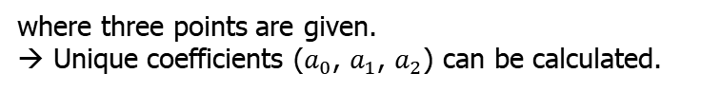

Interpolation vs. Linear Regression
Interpolation
y
Interpolation with Polynomials
40
$y=a_{2}x^{2}+a_{1}x^{1}$+ $a_{0}$
30
where three points are given.
→ Unique coefficients ($a_{0}$, $a_{1}$, $a_{2}$) can be calculated.
20
10
Is this related to Neural Network Training?
1
2
3
x

Slide 10


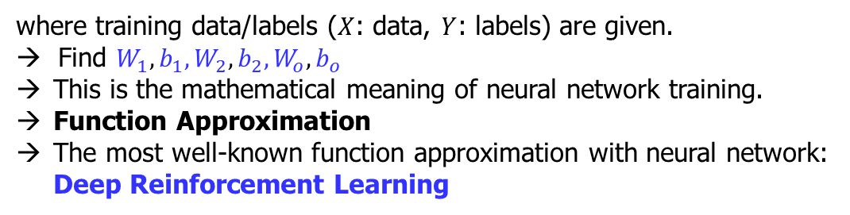
Interpolation and Neural Network Training
$$Y=a\left(a\left(a\left(X∙W_{1}+b_{1}\right)∙W_{2}+b_{2}\right)∙W_{o}+b_{o}\right)$$
where training data/labels ($X$: data, $Y$: labels) are given.
→ Find $W_{1}, b_{1},W_{2},b_{2},W_{o},b_{o}$
This is the mathematical meaning of neural network training.
Function Approximation
The most well-known function approximation with neural network: Deep Reinforcement Learning

Slide 11
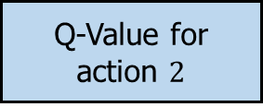
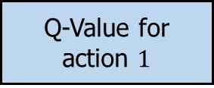
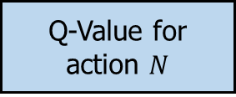
Example (Deep Reinforcement Learning)
It is inefficient to make the Q-table for each state-action pair. → ANN is used to approximate the Q-function.
Output
Q-Value for action $1$
Input
Artificial Neural Network
Q-Value for action $2$
State
……
Q-Value for action $N$

Slide 12
Outline
Deep Reinforcement Learning (DRL) Concepts
Imitation Learning Concepts
Multi-Agent DRL for UAV-based Services

Slide 13
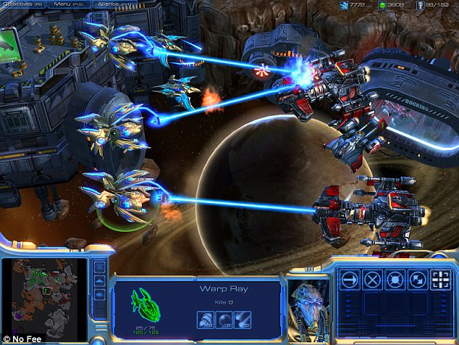
Introduction to Imitation Learning
Gameplay
Pro-Gamer
Trained Agent
The goal of Imitation Learning is to train a policy to mimic the expert’s demonstrations

Slide 14
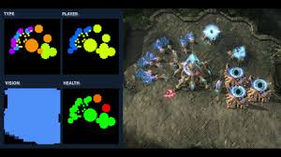
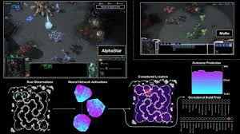
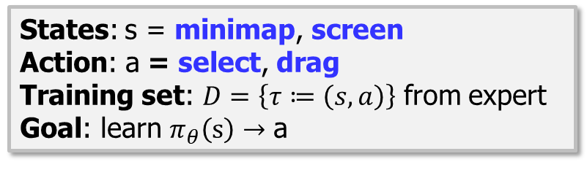

Imitation Learning Applications: Starcraft2
Starcraft2
States: s = minimap, screen
Action: a = select, drag
Training set: $D=\left\{τ≔\left(s,a\right)\right\}$ from expert
Goal: learn $π_{θ}\left(s\right)→$ a
States: s
Action: a
Policy: $π_{θ}$
Policy maps states to actions : $π_{θ}\left(s\right)→a$
Distributions over actions : $π_{θ}\left(s\right)→P(\text{a})$
State Dynamics: $P(\text{s}\text{′|}\text{s}\text{,}\text{a})$
Typically not known to policy
Essentially the simulator/environment
Rollout: sequentially execute $π_{θ}\left(s_{0}\right)$ on initial state
Produce trajectories $τ$
$P(τ|π)$: distribution of trajectories induced by a policy
$P(s|π)$: distribution of states induced by a policy

Slide 15
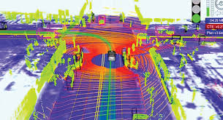
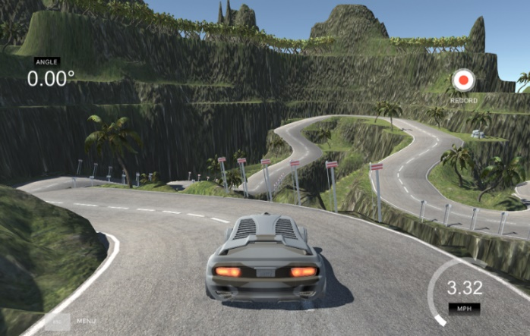
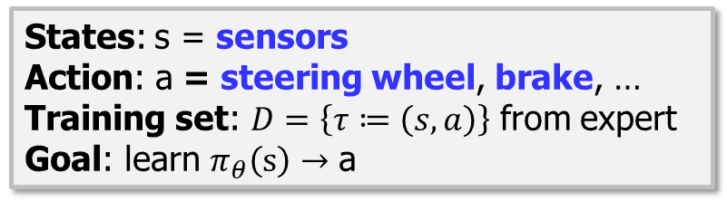
Imitation Learning Applications: Autonomous Driving
Autonomous Driving Control
States: s = sensors
Action: a = steering wheel, brake, …
Training set: $D=\left\{τ≔\left(s,a\right)\right\}$ from expert
Goal: learn $π_{θ}\left(s\right)→$ a

Slide 16

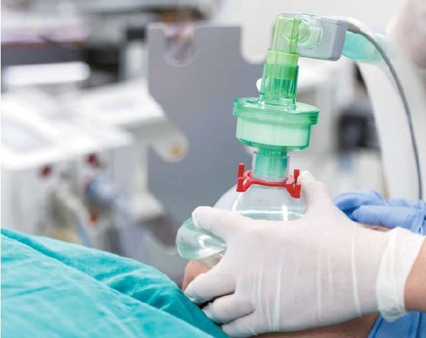
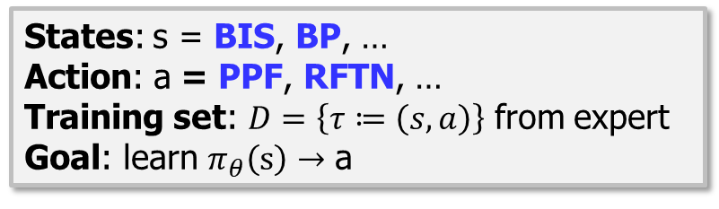
Imitation Learning Applications: PPF/RFTN Injection Control in Medicine
PPF/RFTN Injection Control in Medicine
States: s = BIS, BP, …
Action: a = PPF, RFTN, …
Training set: $D=\left\{τ≔\left(s,a\right)\right\}$ from expert
Goal: learn $π_{θ}\left(s\right)→$ a

Slide 17
Outline
Deep Reinforcement Learning (DRL) Concepts
Imitation Learning Concepts
Multi-Agent DRL for UAV-based Services

Slide 18
Introduction
Soyi Jung, Won Joon Yun, MyungJae Shin, Joongheon Kim, and Jae-Hyun Kim, “Orchestrated Scheduling and Multi-Agent Deep Reinforcement Learning for Cloud-Assisted Multi-UAV Charging Systems,” IEEE Transactions on Vehicular Technology (Under Review).
Collaboration with Ajou University (Prof. Jae-Hyun Kim’s Lab)

Slide 19
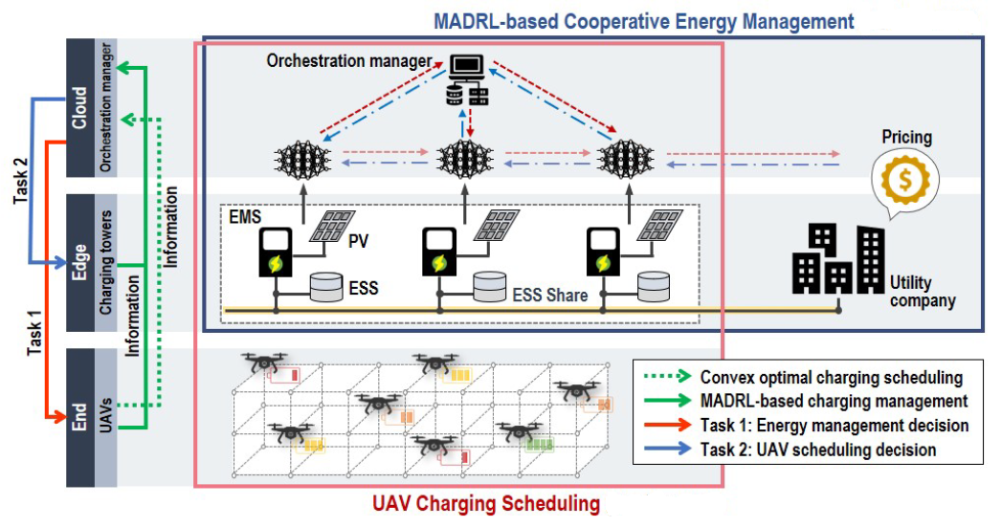
System Model

Slide 20
MADRL for End-Edge-Cloud UAV Charging Systems (CommNet)

Slide 21
Conclusions
Deep Reinforcement Learning
Reinforcement Learning Approximation with Deep Neural Networks
Imitation Learning
Learning without Rewards
One Possible Solutions for Multi-Agent DRL
Multi-Agent DRL
CommNet

Slide 22
Q&A
Thank you for your attention!
More questions?
joongheon@korea.ac.kr
More details?
https://joongheon.github.io/

